Slide 1

CZ3005 Artificial Intelligence Intelligent Agents and Search
Asst/P Hanwang Zhang
https://personal.ntu.edu.sg/hanwangzhang/
Email: hanwangzhang@ntu.edu.sg
Office: N4-02c-87

Slide 2
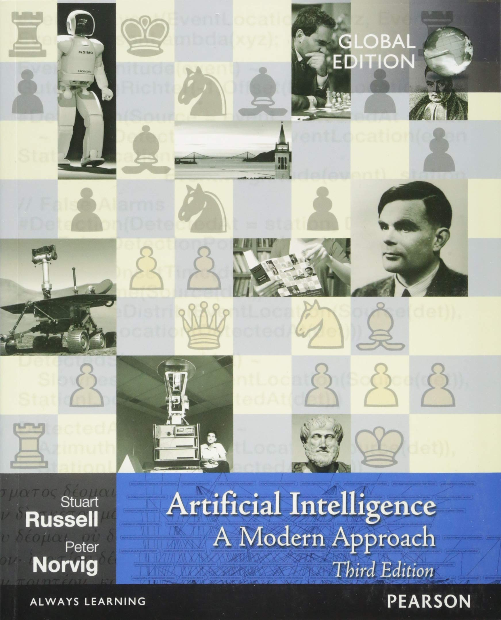
Lesson Outline
How can one describe the task/problem for the agent?
What are the properties of the task environment for the agent?
Problem formulation
Uninformed search strategies
Informed search strategies: greedy search, A * search
Notes:
describe: if you cannot describe, you cannot program
Properties: for different properties of environment, we may have totally different framework. For example, for physical class, and online class, you must have different styles.
Describe in a formal way (program/mathematical way)。
ai probem is all about search: answer finding!!

Slide 3
Agent
An agent is an entity that
Perceives through sensors (e.g. eyes, ears, cameras, infrared range sensors)
Acts through effectors (e.g. hands, legs, motors)
Sensors
Percepts
Environment
?
Agent
Actions
Effectors
Notes:
Everything is agent.
If you can model these terms, you have an AI, the only thing is in the question mark. It is smart or stupid.

Slide 4
Rational Agents
A rational agent is one that does the right thing
Rational action: action that maximises the expected value of an objective performance measure given the percept sequence to date
Rationality depends on/subject to:
performance measure
everything that the agent has perceived so far
built-in knowledge about the environment
actions that can be performed
Notes:
Break down: maximize, expected value, performance measure, given perception to date.
Draw an equation
Read the bullets, go back to the figure.
Break down/interpret each symbol in terms of the bullets listed
R(a|s_t)
R: performance measure+built-in knowledge
A = action, s_t, so far.
Is rational always good? Think about the relationship between you and your spouse? Is it good to be rational? It agains confirms that: rationality is hard to define.

Slide 5
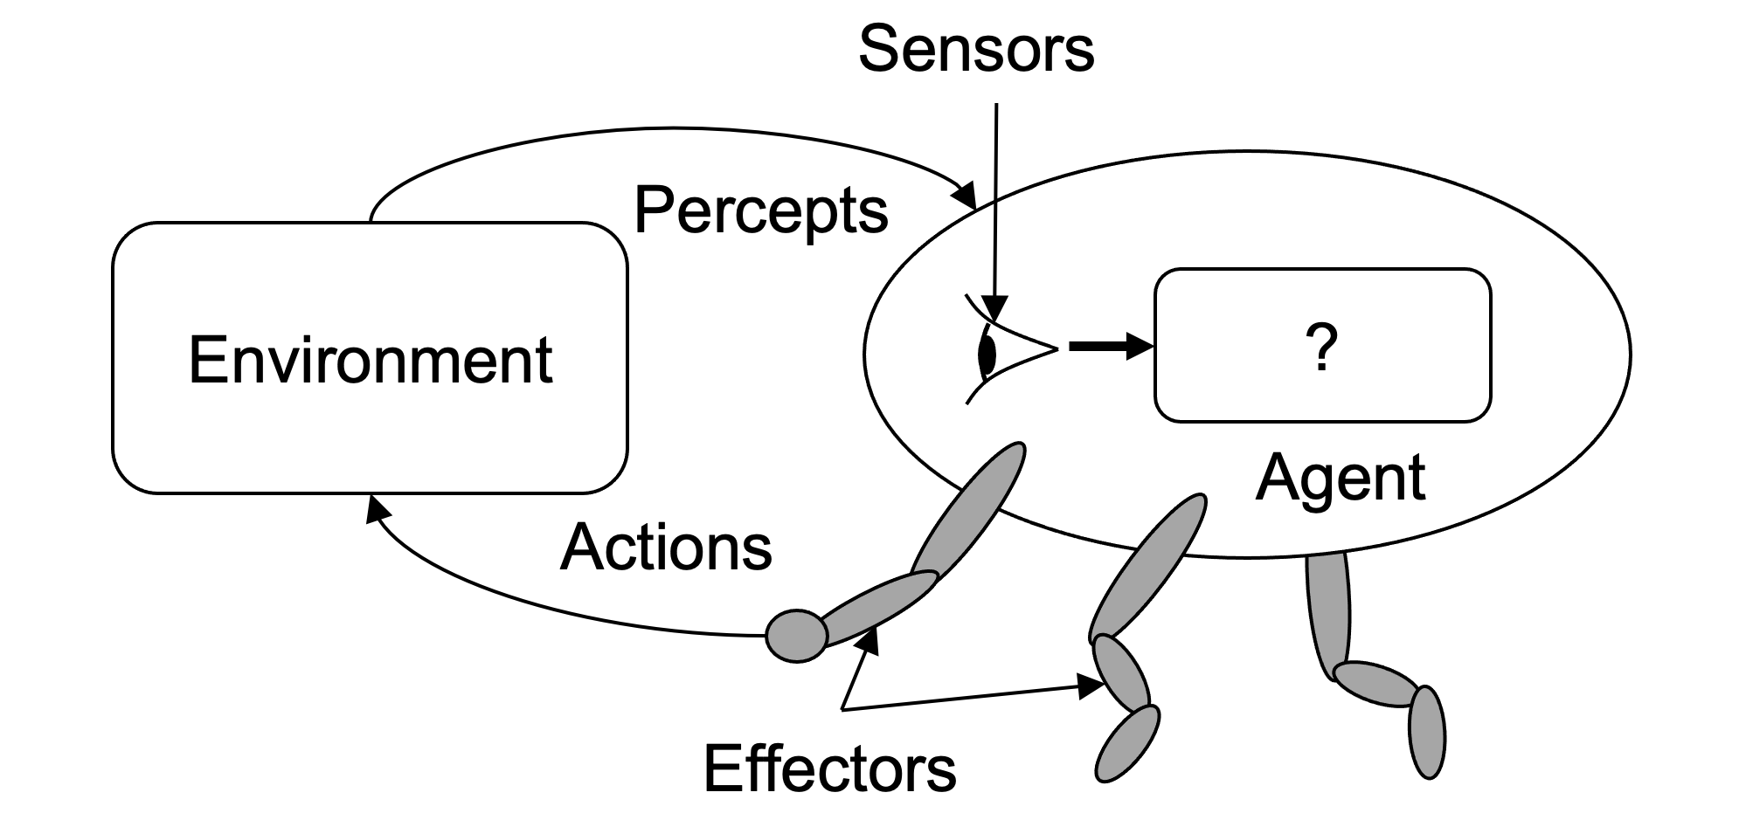
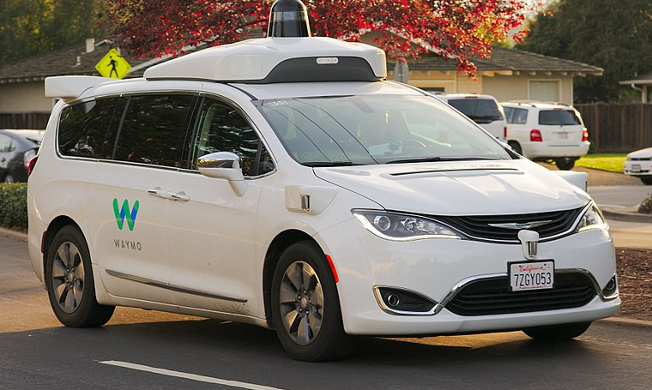
Example: Google X2: Driverless Taxi
Percepts: video, speed, acceleration, engine status, GPS, radar, …
Actions: steer, accelerate, brake, horn, display, …
Goals (Measure): safety, reach destination, maximise profits, obey laws, passenger comfort,…
Environment: Singapore urban streets, highways, traffic, pedestrians, weather, customers, …
Image source: https://en.wikipedia.org/wiki/Waymo#/media/File:Waymo_Chrysler_Pacifica_in_Los_Altos,_2017.jpg

Slide 6
More Examples
Agent Type | Percepts | Actions | Goals | Environment
Medical diagnosis system | Symptoms, findings, patient’s answers | Questions, tests, treatments | Healthy patient, minimize costs | Patient, hospital
Satellite image analysis system | Pixels of varying intensity, color | Print a categorization of scene | Correct categorization | Images from orbiting satellite
Part-picking robot | Pixels of varying intensity | Pick up parts and sorts into bins | Place parts in correct bins | Conveyor belt with parts
Refinery controller | Temperature, pressure readings | Open, close valves; adjust temperature | Maximize purity, yield, safety | Refinery
Interactive English tutor | Typed words | Print exercises, suggestions, corrections | Maximize student’s score on test | Set of students
Notes:
Dont memorize these. These are only defined by you, the designers. It is just a good modularized structure to describe your AI.

Slide 7
Types of Environment
Accessible (vs inaccessible)
Agent's sensory apparatus gives it access to the complete state of the environment
Deterministic (vs nondeterministic)
The next state of the environment is completely determined by the current state and the actions selected by the agent
Episodic (vs Sequential)
Each episode is not affected by the previous taken actions
Static (vs dynamic)
Environment does not change while an agent is deliberating
Discrete (vs continuous)
A limited number of distinct percepts and actions
Notes:
Exam is episodic, tutorial is sequential.

Slide 8
Example: Driverless Taxi
Accessible? | No. Some traffic information on road is missing
Deterministic? | No. Some cars in front may turn right suddenly
Episodic? | No. The current action is based on previous driving actions
Static? | No. When the taxi moves, Other cars are moving as well
Discrete? | No. Speed, Distance, Fuel consumption are in real domains
Notes:
How to make it yes.

Slide 9
Example: Chess
Accessible? | Yes. All positions in chessboard can be observed
Deterministic? | Yes. The outcome of each movement can be determined
Episodic? | No. The action depends on previous movements
Static? | Yes. When there is no clock, when are you considering the next step, the opponent can't move; Semi. When there is a clock, and time is up, you will give up the movement
Discrete? | Yes. All positions and movements are in discrete domains

Slide 10
More Examples
Environment | Accessible | Deterministic | Episodic | Static | Discrete
Chess with a clock Chess without a clock Poker Backgammon Taxi driving Medical diagnosis system Image-analysis system Part-picking robot Refinery controller Interactive English tutor | Yes Yes No Yes No No Yes No No No | Yes Yes No No No No Yes No No No | No No No No No No Yes Yes No No | Semi Yes Yes Yes No No Semi No No No | Yes Yes Yes Yes No No No No No Yes

Slide 11
Design of Problem-Solving Agent
Idea
Systematically considers the expected outcomes of different possible sequences of actions that lead to states of known value
Choose the best one
shortest journey from A to B?
most cost effective journey from A to B?
Notes:
POSSIBLE FUTURE: FUTURE IS VERY IMPORTANT.

Slide 12
Design of Problem-Solving Agent
Steps
1. Goal formulation
2. Problem formulation (states, actions, goal test)
3. Solution (a sequence of legal action execution)
4. Search (algorithm of how to find a good solution)
No knowledge → uninformed search
Knowledge → informed search

Slide 13
Example: Romania
Goal: be in Bucharest
Problem:
states: various cities
actions: drive between cities
goal test: city == Bucharest?
Solution:
sequence of cities, e.g., Arad, Sibiu, Fagaras, Bucharest
Oradea
Neamt
Zerind
Arad
lasi
Sibiu
Fagaras
Vasliu
Timisoara
Rimnicu Vilcea
Lugoj
Pitesti
Hirsova
Urziceni
Mehadia
Bucharest
Dobreta
Eforie
Craiova
Giurgiu

Slide 14
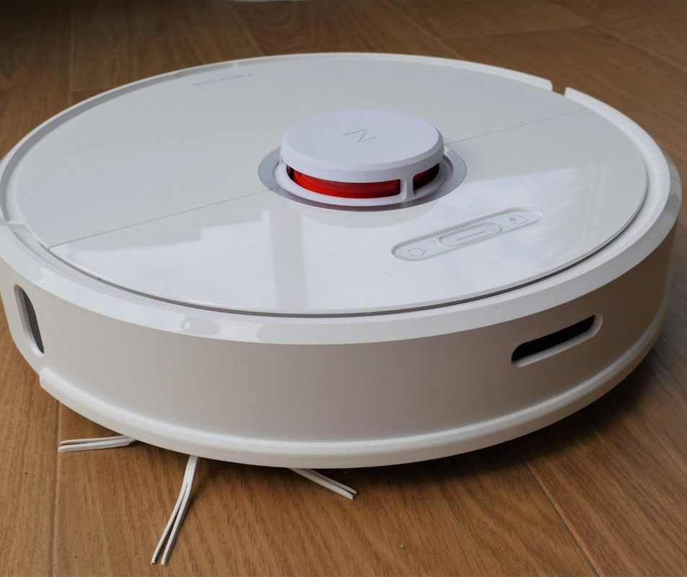
Example: Vacuum Cleaner Agent
Robotic vacuum cleaners move autonomously
Some can come back to a docking station to charge their batteries
A few are able to empty their dust containers into the dock as well

Slide 15



Example: A Simple Vacuum World
Two locations, each location may or may not contain dirt, and the agent may be in one location or the other
1
2
3
4
5
6
7
8
States: 8 possible world states
Actions: left, right, and suck
Goal: clean up all dirt Two goal states, i.e. {7, 8}
Notes:
Ask a question, what is goal test?

Slide 16
Single-State Problem
Accessible world state (sensory information is available)
Known outcome of action (deterministic)
e.g.: start in #5
Solution: right, suck
1
2
3
4
5
6
7
8

Slide 17
Multiple-State Problem
Inaccessible world state (with limited sensory information):
agent only knows which sets of states it is in
Known outcome of action (deterministic)
e.g.: start in {1, 2, 3, 4, 5, 6, 7, 8}
Action right goes to {2, 4, 6, 8}
Solution: right, suck, left, suck
1
2
3
4
5
6
7
8

Slide 18
Well-Defined Formulation
Definition of a problem | Re-state the goal with more specification (rules, resource, see below)
Formulation | Initial state Action set, i.e. available actions (successor functions) State space, i.e. states reachable from the initial state Solution path: sequence of actions from one state to another Goal test predicate Single state, enumerated list of states, abstract properties Cost function Path cost g(n), sum of all (action) step costs along the path
Solution (Legal play) | A path (a sequence of operators leading) from the Initial-State to a state that satisfies the Goal-Test
Notes:
We will illustrate a little bit about the legal play this class and show how to expand the legal play in the next two classes.
We have a new conset: cost function. Similar to the reward.

Slide 19
Measuring Problem-Solving Performance
Search Cost
What does it cost to find the solution?
e.g. How long (time)? How many resources used (memory)?
Total cost of problem-solving
Search cost (“offline") + Execution cost (“online")
Trade-offs often required
Search a very long time for the optimal solution, or
Search a shorter time for a “good enough" solution
Notes:
MOST AI adopts the second, as there is optimality yet.

Slide 20
Single-State Problem Example
Initial state: e.g., “at Arad“
Set of possible actions and the corresponding next states
e.g., Arad → Zerind
Goal test:
explicit (e.g., x = “at Bucharest")
Path cost function
e.g., sum of distances, number of operators executed solution: a sequence of operators leading from the initial state to a goal state
Oradea
Neamt
Zerind
lasi
Arad
Sibiu
Fagaras
Vasliu
Rimnicu Vilcea
Timisoara
Urziceni
Lugoj
Hirsova
Pitesti
Mehadia
Bucharest
Eforie
Dobreta
Craiova
Giurgiu

Slide 21
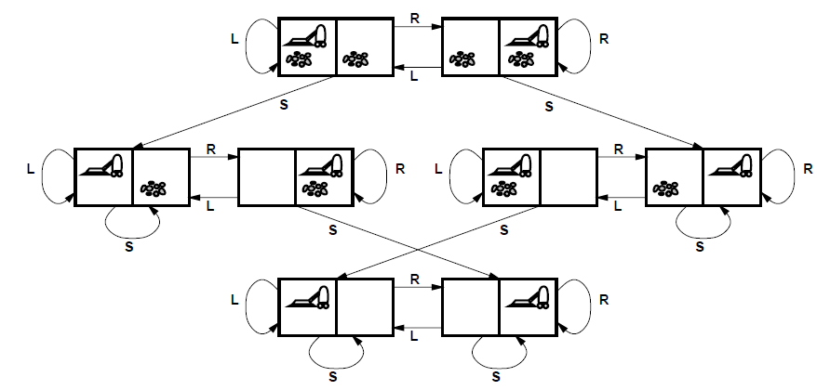
Example: Vacuum World (Single-state Version)
Initial state: one of the eight states shown previously
Actions: left, right, suck
Goal test: no dirt in any square
Path cost: 1 per action
Notes:
Note that it is 1 PER ACTION, not total

Slide 22
Multiple-State Problem Formulation
Initial state set
Set of possible actions and the corresponding sets of next states
Goal test
Path cost function
Solution:
a path (connecting sets of states) that leads to a set of states all of which are goal states

Slide 23
Example: Vacuum World (Multiple-state Version)
States: subset of the eight states
Operators: left, right, suck
Goal test: all states in state set have no dirt
Path cost: 1 per operator

Slide 24
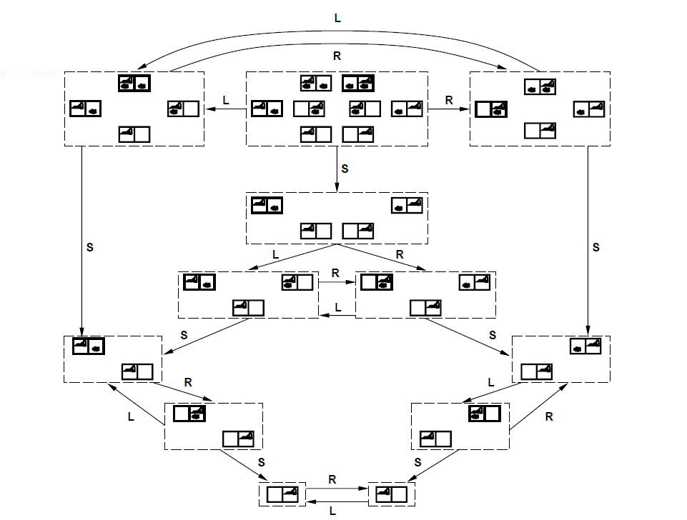
Example: Vacuum World (Multiple-state Version)

Slide 25
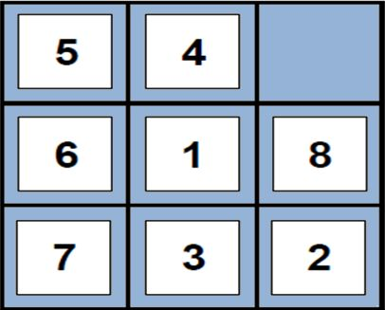
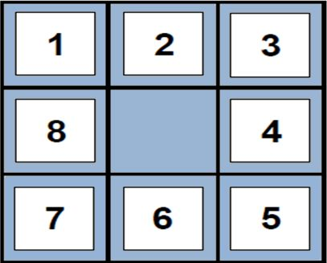
Example: 8-puzzle
States: integer locations of tiles
number of states = 9!
Actions: move blank left, right, up, down
Goal test: = goal state (given)
Path cost: 1 per move
Start state
Goal state
Notes:
Remind that alpha goal is a multiple state.

Slide 26

Real-World Problems
Route finding problems:
Routing in computer networks
Robot navigation
Automated travel advisory
Airline travel planning
Touring problems:
Traveling Salesperson problem
“Shortest tour": visit every city exactly once

Slide 27
Question to Think About
Notes:
Like the vacuum example, it is easy to enumerate all the possible paths.

Slide 28
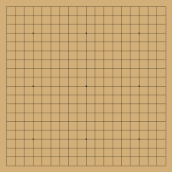
AlphaGo
https://forms.gle/dmFLBxgx7kBktFPdA
Notes:
So far, we can feel that the expansion of the solution path will be very large. Next, we will consider how to efficiently search large space or how to smartly shrink the large space.

Slide 29
Search Algorithms
Exploration of state space by generating successors of already-explored states
Frontier: candidate nodes for expansion
Explored set
Arad
Timisoara
Zerind
Sibiu
Arad
Rimnicu
Vilcea
Fagaras
Oradea
Sibiu
Bucharest
Notes:
Using node and edges are very general representation of the search space, like the vacuum machine example.
Before we start, recap: queue and stack.

Slide 30
Search Strategies
A strategy is defined by picking the order of node expansion.
Strategies are evaluated along the following dimensions:
Completeness | Does it always find a solution if one exists?
Time Complexity | How long does it take to find a solution: the number of nodes generated
Space Complexity | Maximum number of nodes in memory
Optimality | Does it always find the best (least-cost) solution?

Slide 31
Uninformed vs Informed
Uninformed search strategies
Use only the information available in the problem definition
Breadth-first search
Uniform-cost search
Depth-first search
Depth-limited search
Iterative deepening search
Informed search strategies
Use problem-specific knowledge to guide the search
Usually more efficient
Notes:
Use min X^2 as an example.

Slide 32

Breadth-First Search
Expand shallowest unexpanded node which can be implemented by a First-In-First-Out (FIFO) queue
1
A
2
A
3
A
4
A
B
C
B
C
B
C
D
E
D
E
F
G
Denote
b: maximum branching factor of the search tree
d: depth of the solution
Complete: Yes
Optimal: Yes when all step costs equally
Notes:
A VERY IMPORTANT ASSUMPTION: GOAL STATE (END STATE), QUIT! Differentiate between the solution cost and the search cost of the algorithm itself.

Slide 33
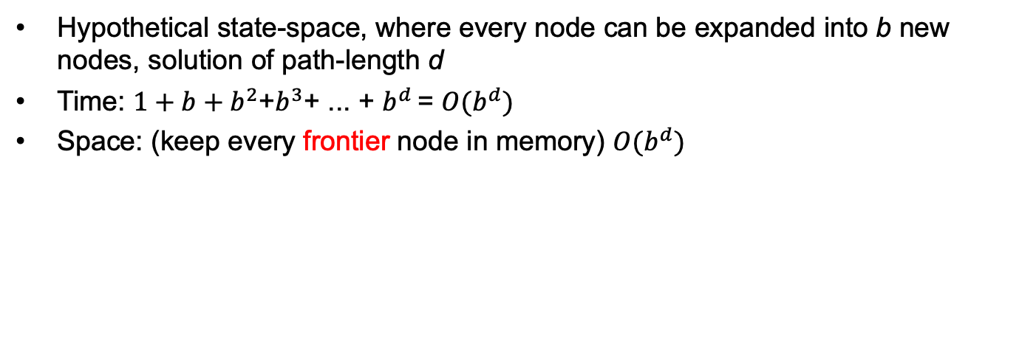
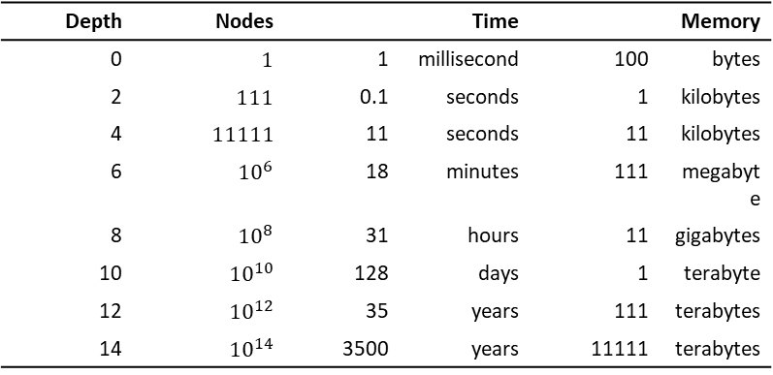
Complexity of BFS
Hypothetical state-space, where every node can be expanded into b new nodes, solution of path-length d
Time: $1+b+b^{2}$+$b^{3}$+ ... + $b^{d }$= $O(b^{d})$
Space: (keep every frontier node in memory) $O(b^{d})$
Depth | Nodes | Time |  | Memory
0 | $$1$$ | 1 | millisecond | 100 | bytes
2 | $$111$$ | 0.1 | seconds | 1 | kilobytes
4 | $$11111$$ | 11 | seconds | 11 | kilobytes
6 | $${10}^{6}$$ | 18 | minutes | 111 | megabyte
8 | $${10}^{8}$$ | 31 | hours | 11 | gigabytes
10 | $${10}^{10}$$ | 128 | days | 1 | terabyte
12 | $${10}^{12}$$ | 35 | years | 111 | terabytes
14 | $${10}^{14}$$ | 3500 | years | 11111 | terabytes
Notes:
Note that the space is the worst case space.

Slide 34
Uniform-Cost Search
To consider edge costs, expand unexpanded node with the least path cost g
Modification of breath-first search
Instead of First-In-First-Out (FIFO) queue, using a priority queue with path cost g(n) to order the elements
BFS = UCS with g(n) = Depth(n)
A
1
10
5
B
5
S
G
15
5
C
Notes:
How to prove: BFS = UCS with cost 1 per move?

Slide 35
Uniform-Cost Search
1
2
A
S
S
10
0
1
A
B
C
5
B
5
G
1 5 15
S
4
S
3
S
15
5
C
A
B
C
A
B
C
15
5 15
G
G
G
11 10
11
Here we do not expand notes that have been expanded.
Notes:
Link this to S, pi, D.

Slide 36
Uniform-Cost Search
Complete | Yes
Time | # of nodes with path cost g <= cost of optimal solution (eqv. # of nodes pop out from the priority queue)
Space | # of nodes with path cost g <= cost of optimal solution
Optimal | Yes
Notes:
Ask a question: shortest path is well-know for its polynomial, but why here it is b^d? exponential. (different measure: number of nodes)
What's missing? Priority Q time complexity? Absorbed by b^d + blogb d.

Slide 37
Depth-First Search
Expand deepest unexpanded node which can be implemented by a Last-In-First-Out (LIFO) stack, Backtrack only when no more expansion
1
A
2
A
3
A
4
A
5
A
6
A
B
C
B
C
B
C
B
C
B
C
D
E
D
E
D
E
E
7
A
8
A
H
I
I
B
9
A
10
A
11
A
12
A
C
B
C
E
C
C
C
C
E
J
K
F
G
F
G
F
G
K
L
M
M
Notes:
For space limits, popout nodes (explored nodes) are removed

Slide 38
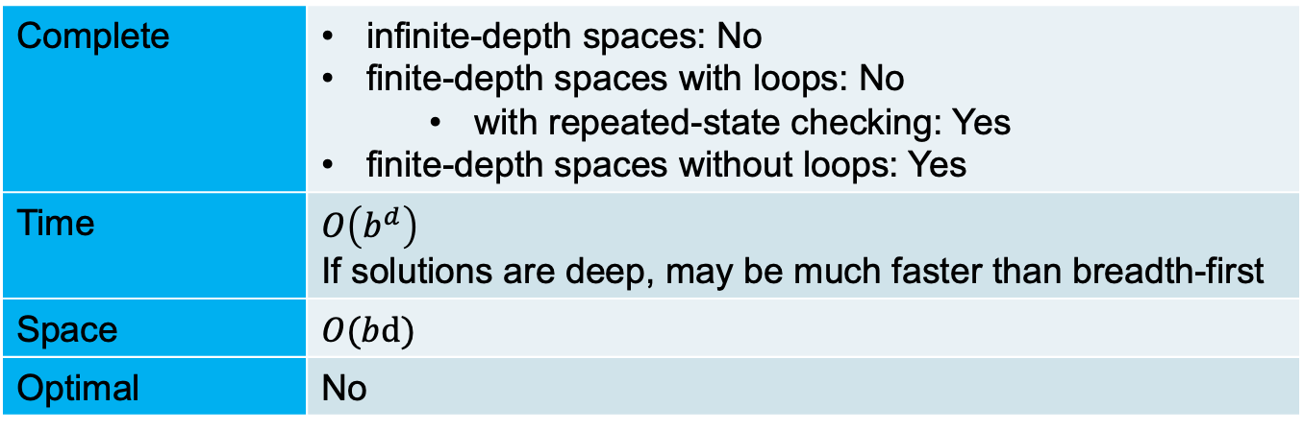
Depth-First Search
Denote
d: maximum depth of the state space
Complete | infinite-depth spaces: No finite-depth spaces with loops: No with repeated-state checking: Yes finite-depth spaces without loops: Yes
Time | $$O\left(b^{d}\right)$$ If solutions are deep, may be much faster than breadth-first
Space | $$O(bd)$$
Optimal | No
No
No
Yes
Yes
No
Notes:
Time: same as bfs, as it also expands all the nodes. Solutions are deep, not dense.
Space: every time only expands b, m times, so it is bm.

Slide 39
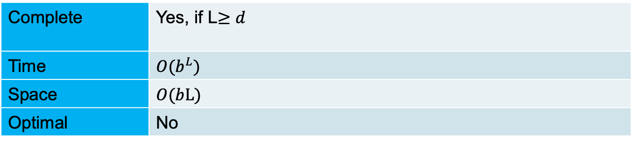
Depth-Limited Search
To avoid infinite searching, Depth-first search with a cutoff on the max depth / of a path
Complete | Yes, if L$≥d$
Time | $$O(b^{L})$$
Space | $$O(bL)$$
Optimal | No

Slide 40
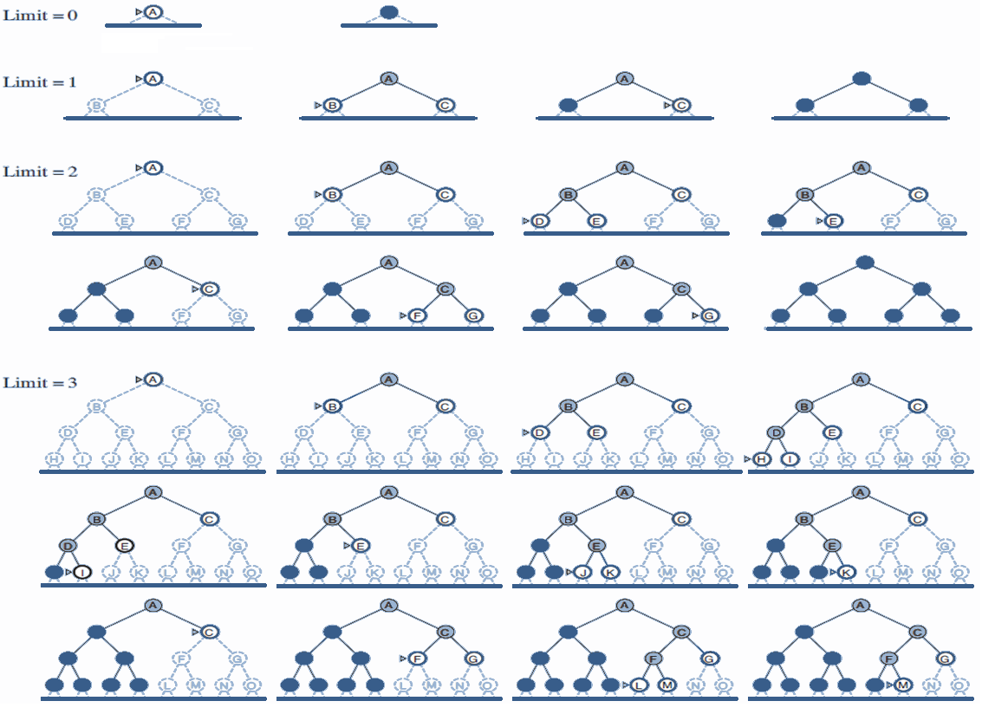
Iterative Deepening Search
Iteratively estimate the max depth / of DLS one-by-one
Limit = 0
Limit = 1
Notes:
IDS combines good of both bfs and dfs.

Slide 41
Iterative Deepening Search
Iteratively estimate the max depth / of DLS one-by-one
Limit = 2

Slide 42
Iterative Deepening Search
Iteratively estimate the max depth / of DLS one-by-one
Limit = 3

Slide 43
Iterative Deepening Search...
Function ITERATIVE-DEEPENING-SEARCH(problem) returns a solution sequence
inputs: problem, a problem
for depth $0$ to ∞ do
if DEPTH-LIMITED-SEARCH(problem, depth) succeeds then return its result
end
return failure
Complete | Yes
Time | $$O(b^{d}\text{)}$$
Space | $$O(bd\text{)}$$
Optimal | Yes
Notes:
Since iterative deepening visits states multiple times, it may seem wasteful, but it turns out to be not so costly, since in a tree most of the nodes are in the bottom level, so it does not matter much if the upper levels are visited multiple times
O(b^1)+o(b^2)+o(b^3) +.....+O(b^d) = O(b^d)
why optimal? Assumption Cost per move = 1. In DFS, non optimal happens when the

Slide 44
CZ3005 Artificial Intelligence Intelligent Agents and Search
Asst/P Hanwang Zhang
https://personal.ntu.edu.sg/hanwangzhang/
Email: hanwangzhang@ntu.edu.sg
Office: N4-02c-87

Slide 45
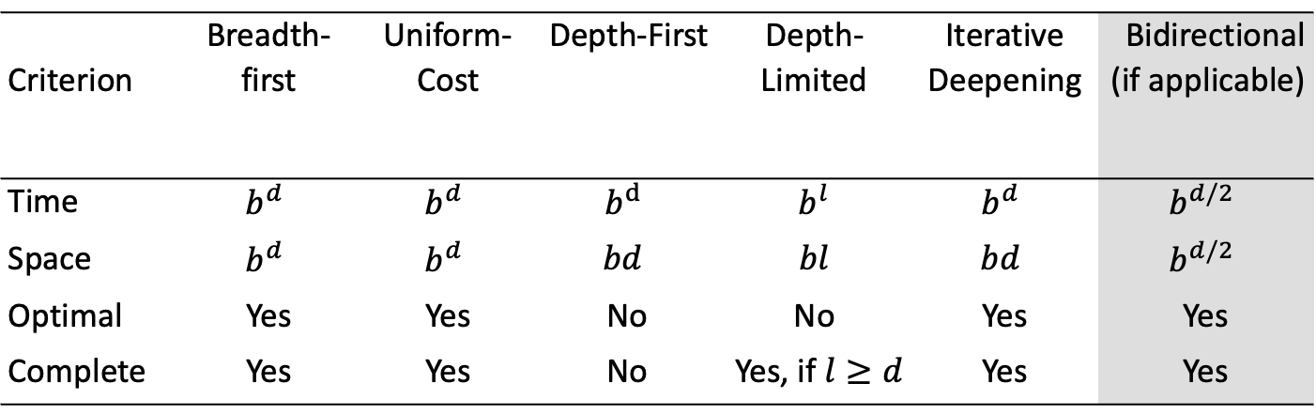
Summary (we make assumptions for optimality)
Criterion | Breadth-first | Uniform-Cost | Depth-First | Depth-Limited | Iterative Deepening | Bidirectional (if applicable)
Time | $$b^{d}$$ | $$b^{d}$$ | $$b^{d}$$ | $$b^{l}$$ | $$b^{d}$$ | $$b^{d/2}$$
Space | $$b^{d}$$ | $$b^{d}$$ | $$bd$$ | $$bl$$ | $$bd$$ | $$b^{d/2}$$
Optimal | Yes | Yes | No | No | Yes | Yes
Complete | Yes | Yes | No | Yes, if $l≥d$ | Yes | Yes
Notes:
Time: all exponential with respect to branching factor and depth. Why? In worst case, has to expand all nodes.
Space: two camps. One exponential. Why? BFS has to expand all nodes at every level, DFS only expands one node each time. Again why? Queue vs. Stack.
Optimality: assumptions. Why DFS no? example: it may miss the earlier nodes. How to turn no to yes? Only case: balanced tree and at btm.
Complete: why yes BFS? Eventually complete all the nodes, why not DFS? Maybe trapped in infinite depth or loops. How to make BFS no? infinite breadth.
Marriage of BFS and DFS: IDS.

Slide 46
General Search
Uninformed search strategies
Systematic generation of new states (→Goal Test)
Inefficient (exponential space and time complexity)
Informed search strategies
Use problem-specific knowledge
To decide the order of node expansion
Best First Search: expand the most desirable unexpanded node
Use an evaluation function to estimate the “desirability" of each node
Notes:
So far, Uninformed search is not intelligent, its merely Automatic.
What is the main purpose of informed search: trade off completeness with efficiency. Can greatly minimize the search space without loss of too much completeness. Or, trim the search tree in a wise way.

Slide 47
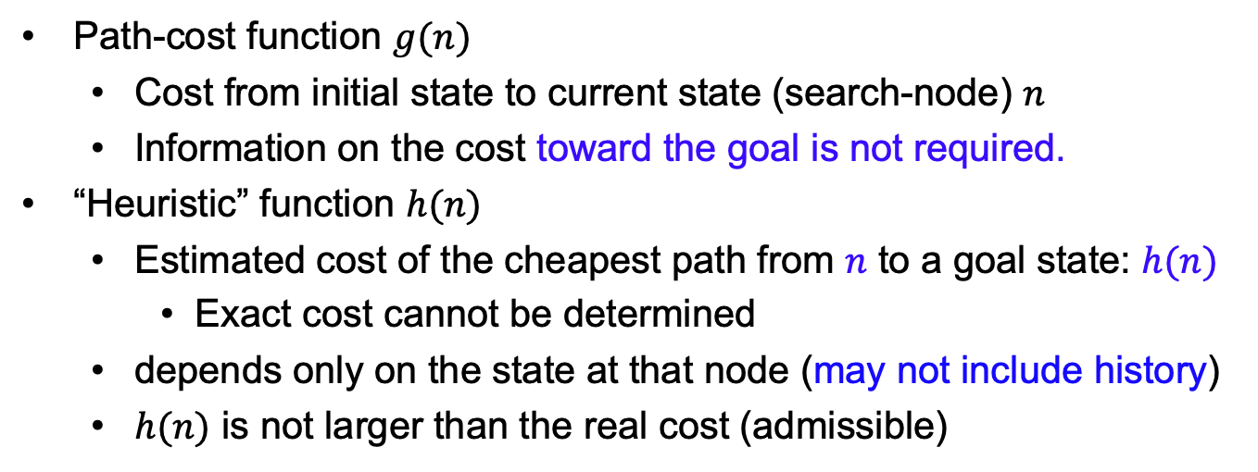
Evaluation function
Path-cost function $g(n)$
Cost from initial state to current state (search-node) $n$
Information on the cost toward the goal is not required.
“Heuristic” function $h(n)$
Estimated cost of the cheapest path from $n$ to a goal state: $h(n)$
Exact cost cannot be determined
depends only on the state at that node (may not include history)
$h(n)$ is not larger than the real cost (admissible)
Notes:
AI is all about estimating the future, if you can predict the future, you are the oracle, you are intelligent. Now, show the google form example.

Slide 48
Greedy Search
Expands the node that appears to be closest to goal
Evaluation function $h(n)$:estimate of cost from $n$ to $goal$
Function Greedy-Search(problem) returns solution
Return Best-First-Search(problem, $h$) // $h\left(goal\right)=0$
Question: How to estimation the cost from $n$ to goal?
Answer: Recall that we want to use problem-specific knowledge

Slide 49
Example: Route-finding from Arad to Bucharest
$h\left(n\right)$ = straight-line distance from $n$ to Bucharest
Straight-line distance to Bucharest
Arad
Bucharest
Craiova
Dobreta
Efoire
Fagaras
Giurgiu
Hirsova
Lasi
Lugoj
Mehadia
Neamt
Oradea
Pitesti
Rimnicu Vilcea
Sibiu
Timisoara
Urziceni
Vaslui
Zerind
366
0
160
242
161
176
77
151
226
244
241
234
380
98
193
253
329
80
199
374
71
Oradea
Neamt
Zerind
151
87
75
Lasi
Arad
140
Sibiu
99
Fagaras
92
118
Vaslui
80
Rimnicu Vilcea
142
Timisoara
211
Lugoj
97
Pitesti
98
Hirsova
111
85
70
146
101
Urziceni
86
Mehadia
138
Bucharest
75
90
Eforie
Dobreta
Craiova
Giurgiu
120
Useful but potentially fallible (heuristic)
Heuristic functions are problem-specific

Slide 50
Example
The initial state
Straight-line distance to Bucharest
Arad
Arad
Bucharest
Craiova
Dobreta
Efoire
Fagaras
Giurgiu
Hirsova
Lasi
Lugoj
Mehadia
Neamt
Oradea
Pitesti
Rimnicu Vilcea
Sibiu
Timisoara
Urziceni
Vaslui
Zerind
366
0
160
242
161
176
77
151
226
244
241
234
380
98
193
253
329
80
199
374
366

Slide 51
Example
After expanding Arad
Straight-line distance to Bucharest
Arad
Arad
Bucharest
Craiova
Dobreta
Efoire
Fagaras
Giurgiu
Hirsova
Lasi
Lugoj
Mehadia
Neamt
Oradea
Pitesti
Rimnicu Vilcea
Sibiu
Timisoara
Urziceni
Vaslui
Zerind
366
0
160
242
161
176
77
151
226
244
241
234
380
98
193
253
329
80
199
374
Sibiu
Timisoara
Zerind
253
329
374

Slide 52
Example
After expanding Sibiu
Straight-line distance to Bucharest
Arad
Arad
Bucharest
Craiova
Dobreta
Efoire
Fagaras
Giurgiu
Hirsova
Lasi
Lugoj
Mehadia
Neamt
Oradea
Pitesti
Rimnicu Vilcea
Sibiu
Timisoara
Urziceni
Vaslui
Zerind
366
0
160
242
161
176
77
151
226
244
241
234
380
98
193
253
329
80
199
374
Sibiu
Timisoara
Zerind
329
374
Arad
Oradea
366
Fagaras
Rimnicu Vilcea
380
176
193

Slide 53

Example
After expanding Fagaras
Straight-line distance to Bucharest
Arad
Arad
Bucharest
Craiova
Dobreta
Efoire
Fagaras
Giurgiu
Hirsova
Lasi
Lugoj
Mehadia
Neamt
Oradea
Pitesti
Rimnicu Vilcea
Sibiu
Timisoara
Urziceni
Vaslui
Zerind
366
0
166
242
161
176
77
151
226
244
241
234
380
98
193
253
329
80
199
374
Sibiu
Timisoara
Zerind
329
374
Arad
Oradea
366
Fagaras
Rimnicu Vilcea
380
193
Sibiu
Bucharest
253
0

Slide 54
Complete?
Question: Is this approach complete?
Example: Find a path from Lasi to Fagaras
R
Oradea
Neamt
Zerind
Arad
Lasi
Sibiu
Fagaras
Vaslui
Timisoara
Rimnicu Vilcea
Lugoj
Pitesti
Hirsova
Urziceni
Mehadia
Bucharest
Dobreta
Eforie
Craiova
Giurgiu
Answer: No
Notes:
why no?
if bfs-->Yes, but in general, if inifinite depth or loop. or deadend. never turned back or turning back cost very expensive.

Slide 55
Greedy Search...
m: maximum depth of the search space
Complete | No
Time | $$O(b^{m}\text{)}$$
Space | $$O(b^{m}\text{)(}\text{keeps} \text{all} \text{nodes} \text{in} \text{memory}\text{)}$$
Optimal | No
Notes:
1. why space is b^m?
2. why on earth we need greedy search, as it has two Nos.

Slide 56
A * Search
Uniform-cost search
g(n): cost to reach n (Past Experience)
optimal and complete, but can be very inefficient
Greedy search
h(n): cost from n to goal (Future Prediction)
neither optimal nor complete, but cuts search space considerably

Slide 57
A * Search
Idea: Combine Greedy search with Uniform-Cost search
Evaluation function: $f\left(n\right)=g\left(n\right)+h(n)$
f (n): estimated total cost of path through n to goal (Whole Life)
If g = 0 → greedy search; If h = 0 → uniform-cost search
Function A* Search(problem) returns solution
Return Best-First-Search$($problem, $g+h)$

Slide 58

Example: Route-finding from Arad to Bucharest
Best-first-search with evaluation function $g+h$
(a) The initial state
(b) After expanding Arad
(c) After expanding Sibiu
Arad
Arad
Arad
366 = 0 + 366
Zerind
Sibiu
Zerind
Sibiu
Timisoara
393 = 140 + 253
449 = 75 + 374
449 = 75 + 374
447 = 118 + 329
Timisoara
Arad
Oradea
447 = 118 + 329
646 = 280 + 366
Rimnicu Vilcea
671 = 291+ 380
Fagaras
413 = 220 + 193
415 = 239 + 176

Slide 59
Example: Route-finding from Arad to Bucharest
Best-first-search with evaluation function $g+h$
(d) After expanding Rimnicu Vilcea
Arad
Zerind
Sibiu
Timisoara
449 = 75 + 374
Arad
447 = 118 + 329
646 = 280 + 366
Oradea
Rimnicu Vilcea
Fagaras
671 = 291+ 380
415 = 239 + 176
Sibiu
Craiova
Pitesti
553 = 300 + 253
526 = 360 + 166
415 = 317 + 98

Slide 60
Example: Route-finding from Arad to Bucharest
Best-first-search with evaluation function $g+h$
(e) After expanding Fagaras
Arad
Zerind
Sibiu
Timisoara
449 = 75 + 374
Arad
447 = 118 + 329
646 = 280 + 366
Oradea
Rimnicu Vilcea
Fagaras
671 = 291+ 380
Sibiu
Sibiu
Craiova
Bucharest
Pitesti
553 = 300 + 253
591 = 338 + 253
526 = 360 + 166
415 = 317 + 98
450 = 450 + 0

Slide 61
Example: Route-finding from Arad to Bucharest
Best-first-search with evaluation function $g+h$
Arad
(f) After expanding Pitesti
Zerind
Sibiu
Timisoara
449 = 75 + 374
Arad
447 = 118 + 329
646 = 280 + 366
Oradea
Rimnicu Vilcea
Fagaras
671 = 291+ 380
Sibiu
Sibiu
Craiova
Bucharest
Pitesti
553 = 300 + 253
591 = 338 + 253
526 = 360 + 166
450 = 450 + 0
Rimnicu Vilcea
Bucharest
Craiova
418 = 418 + 0
615 = 455 + 160
607 = 414 + 193

Slide 62
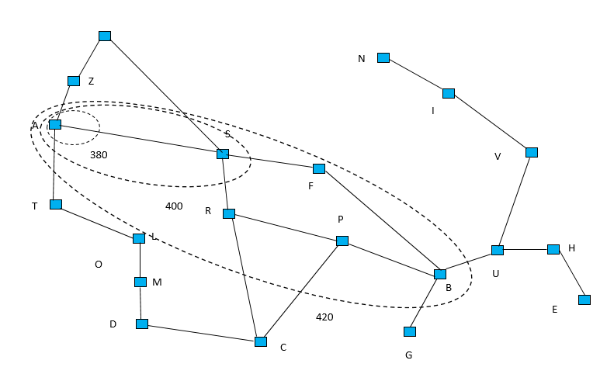
Complexity of A*
Time | $$\text{E}\text{xponential} \text{in} \text{length} \text{of} \text{solution}$$
Space | $$\text{(}\text{all} \text{generated} \text{nodes} \text{are} \text{kept} \text{in} \text{memory}\text{)}$$ $$\text{E}\text{xponential} \text{in} \text{length} \text{of} \text{solution}$$
With a good heuristic, significant savings are still possible compared to uninformed search methods
Notes:
Still exponential. What about completeness and optimality? No. But why helpful? If h is orocle, it is very fast.
https://forms.gle/1j7BhcKYWvK5oTKQ8

Slide 63
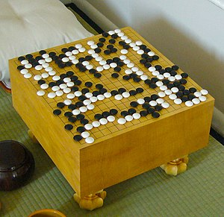
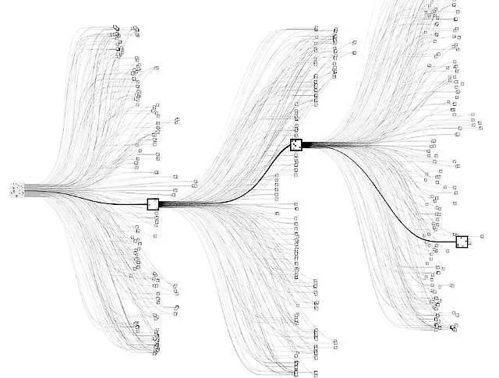


Another Example: Alpha Go
$≈$ #turns
#Moves = 250¹⁵⁰
$≈$ #stone positions

Slide 64
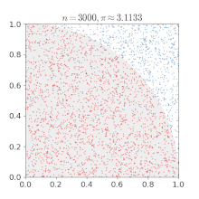
Another Example: Monte Carlo Search Tree (MCST)

Slide 65
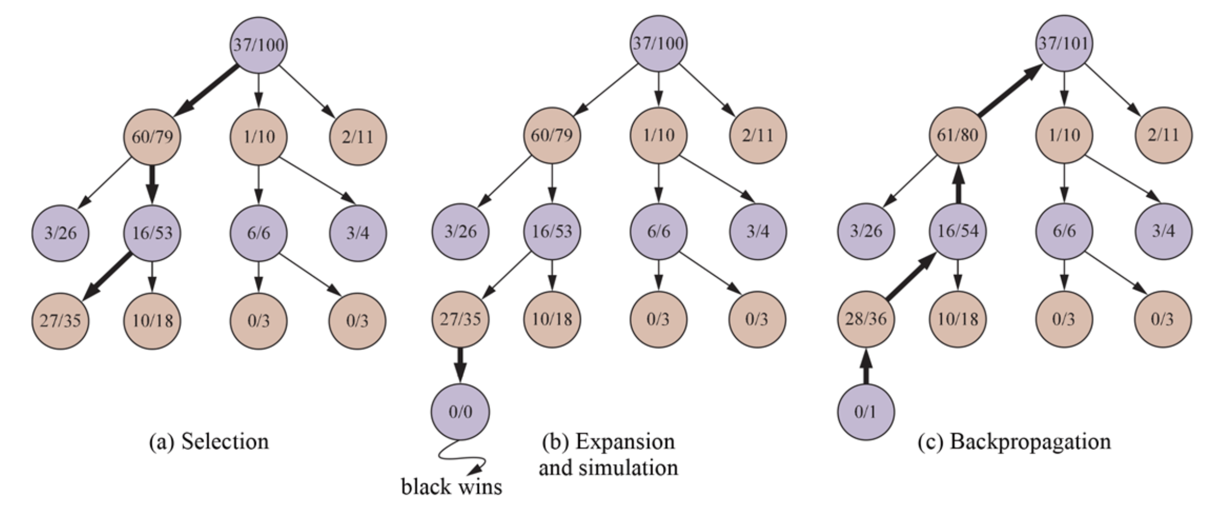
MCST Key Steps
#Wins/#Games
Notes:
Local minimum, two noob player, exploitation vs exploration. Though very fast, but not smart enough.

Slide 66
MCST for Go is very expensive & slow
Why? The deeper you move, the wider you are
→
#number of simulation is exploded
Solution:
For selection/expansion, no longer stats (xx/xx) but f = g+h
For simulation, no longer real self-play but f = g+h

Slide 67
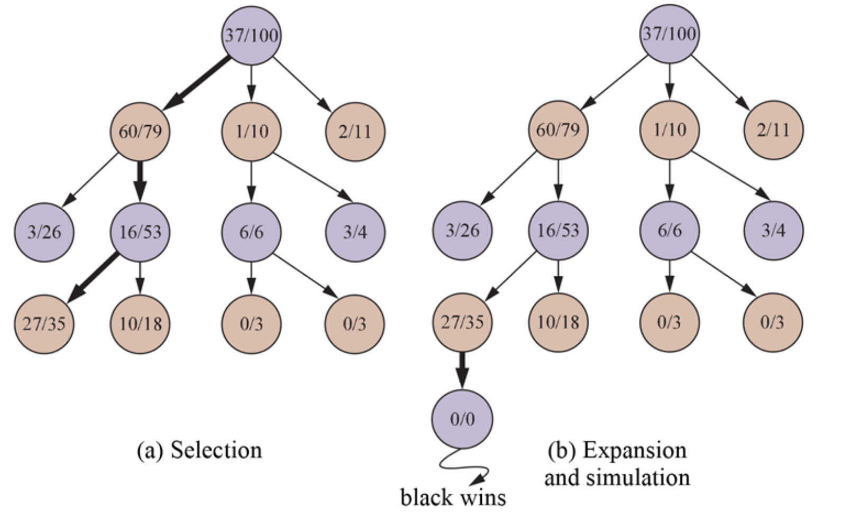
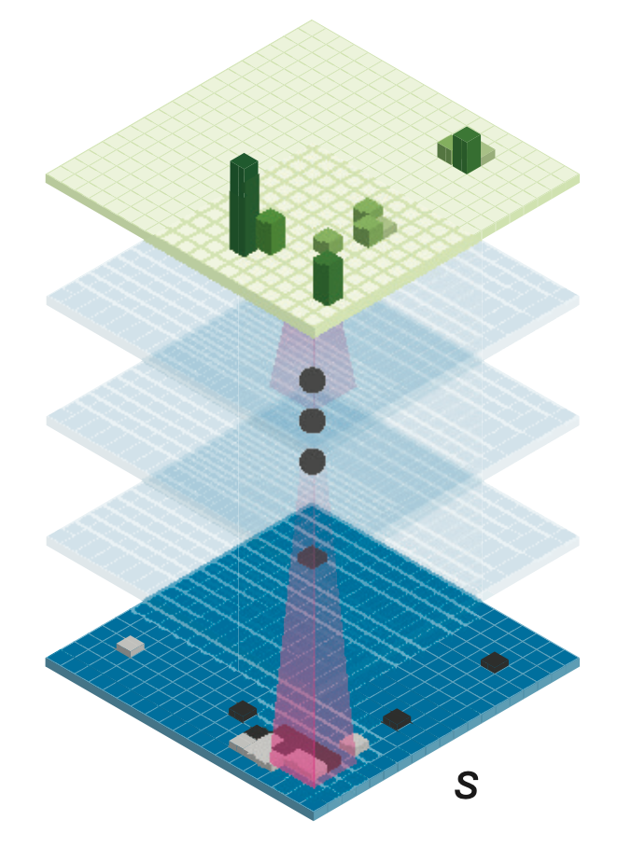
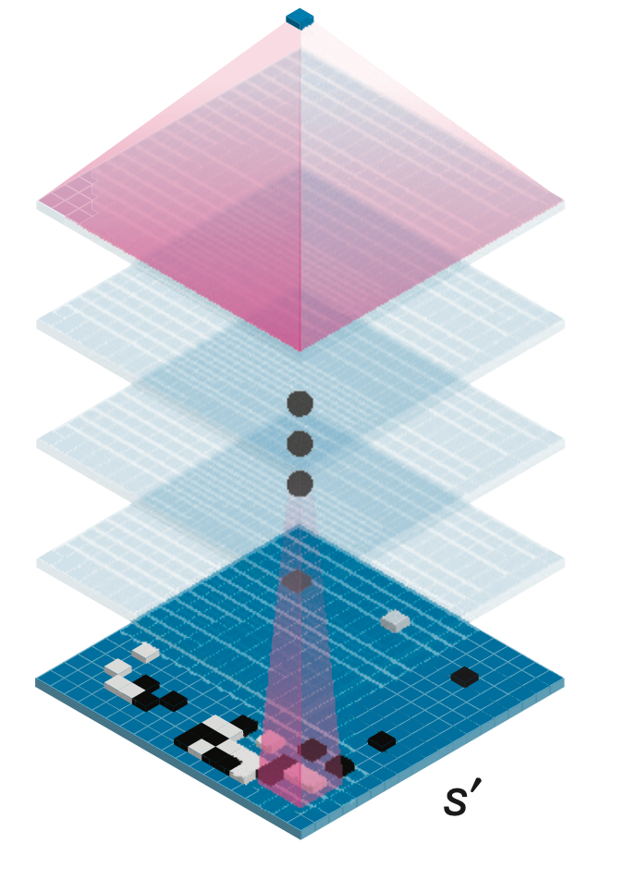
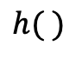
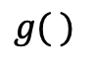
MCST: Update f = g() + h()
Policy Network
Value Network
f
f
$$g( )$$
$$h( )$$
f
f
f
f
f
f
f
f
f
f
f
f
f
f
f
f
f
f
f
f
f
f
f
No real play,
just an estimation

